Slide 1

Data Analysis of EMV Certification Results – Phase 1
Version 1.0 / 12.4.2018

Slide 2

Agenda
Problem statement – Phase 1 discussion
Methodologies
Data Analysis – Step by Step procedures
Observations
Challenges
Phase 2 discussions
Next Steps

Slide 3
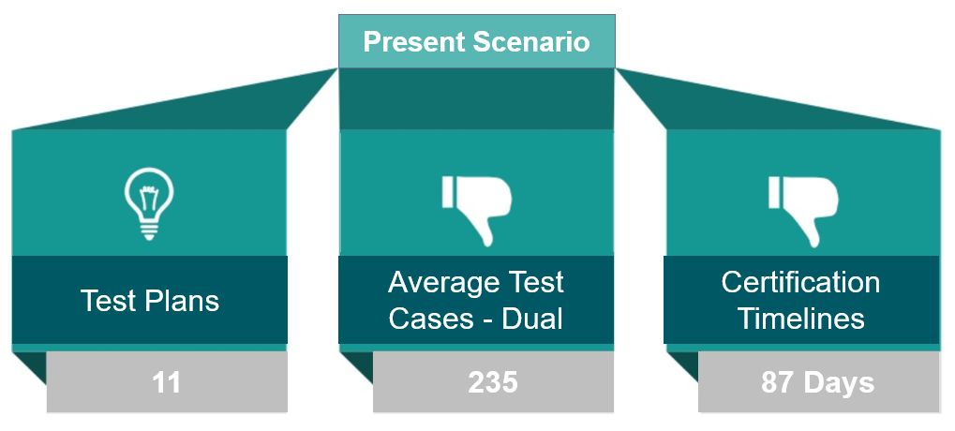

Overview
Problem Statement
Objective
Having a streamlined unified test plan covering all brand requirement with mimimal test cases.
Action Plan: Data Analysis Use Case
Identifying test cases that are more prone to failure than others.
Data source: Blockchain Technology Market Research Report - Global Forecast to 2022
Notes:
UL and First Data developed a very detail oriented 6 step approach to help clients certify their POS solution.

Slide 4


Objective of Data analysis
Overall ~700 EMV Certifications completed – Certpro
Statistical basis for streamlining the test plan than observational
Data analysis of the previous certification will assist us in identifying all the test cases most prone to failure and success.
As an eg. If there is a test case that has a success rate of ~98%, we may consider merging the checks in another test case or even eliminate the checks in the integrated test plan.

Slide 5
Approaches - Certpro Database Data Retrieval
Process followed
Discussion with Dev team
Observations
On every project, they maintain two sessions – One for pre-validation and the other for test execution.
Summary
In this way, we don’t have means to capture the very first iteration results using the DB.
Requesting Certpro database access
Creation of a Dummy project for experimentation
The test results are linked to these sessions. So every time new results are uploaded the test results are updated replacing the older results.

Slide 6
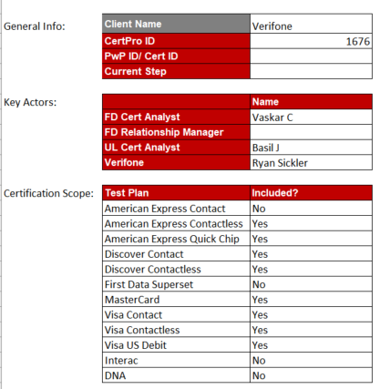
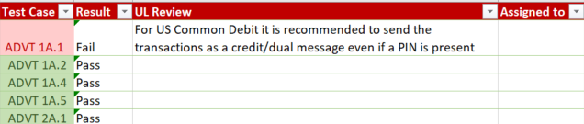
Approaches – Data Retrieval using Certification Progress Reports
Certification Progress Report
Detailed report to the clients indicating Pass/ failure of a test cases and comments
Format : Excel sheet
Information Available: Test case id, status, comments, test plans enabled, Cert pro id, Merchant Name

Slide 7
Approaches – Data Retrieval using Certification Progress Reports
Data Collection:
The sheets were uploaded to share drive by Analysts (Manual efforts)
Overall files received: 48 files
Data Cleaning:
This involved scraping of unwanted data using automation scripts.
Data Analysis Script:
The script is written in python to loop multiple excel sheets in a folder and provide end results (Pass versus Fail) count for each test case.

Slide 8
Results
The results were captured from __ Cert progress reports

Slide 9
Assumptions
No changes to the sheets are done. Like no addition or deletion of rows or columns. The script will be unable to read such files.
Practices across the team to use the Cert Progress report for reporting
Human reporting errors will not be accounted for.

Slide 10
Challenges
Limited sheets uploaded. The reason being that though the process is mandatory, but not everyone in the team are following the process.
People have customized the sheet and formatted in their own way. For automation, consistency in the format is required but a lot of variation was found which cannot be coded dynamically.
Analyst must be made aware that the sheet must be complete and must only capture the first iteration results
27 out of 48 sheets were invalid (56%) – All pass scenario, Incorrect reporting, same file uploaded twice, incomplete with majority test cases pending.

Slide 11
Next steps
Proceeding without enough legitimate data would results in failure of the initiative.
Working with each analyst individually for sometime to fetch the required data.
Understand what additional information do we need to analyze as part of bigger picture.

Slide 12
Thank You.

